Slide 1
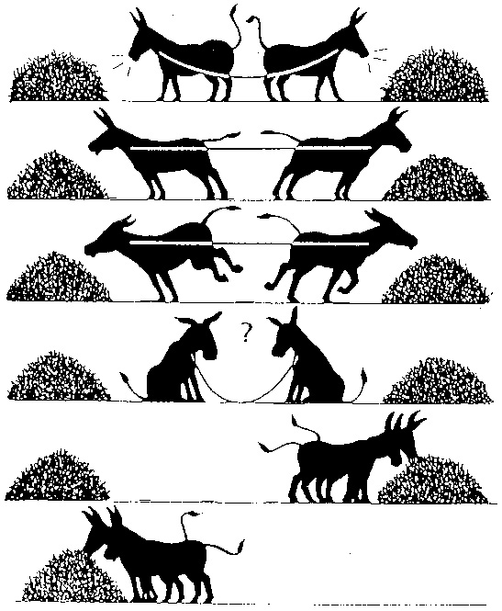

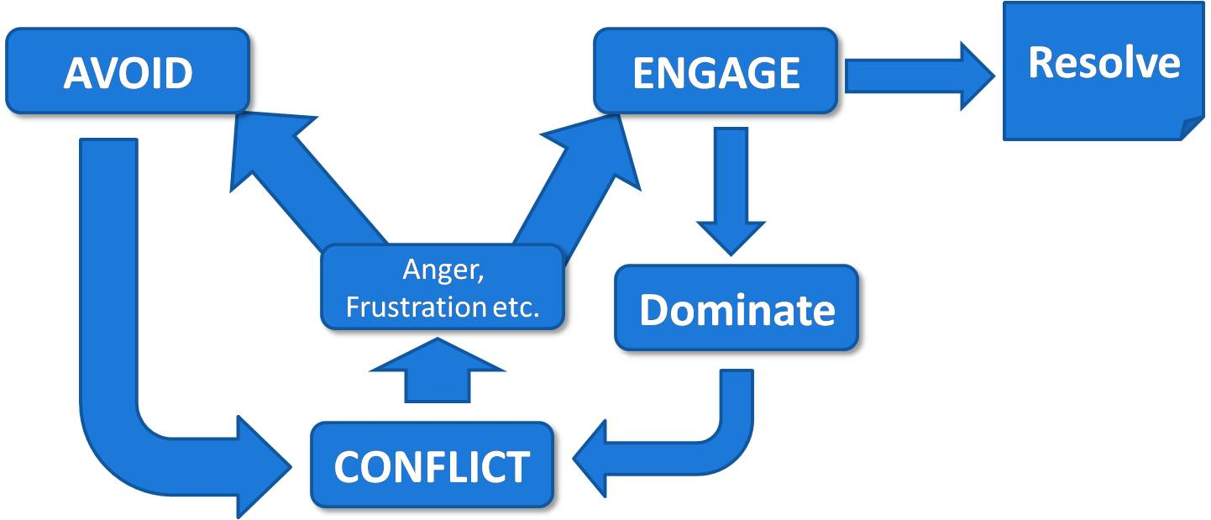
Public Service Announcement
Conflict Resolution
PSA

Slide 2

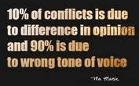
What is a PSA?
PSA is short for Public Service Announcement. They are commercials aimed at educating the general public about issues of concern.
Your assignment is to work with a partner or group to create a PSA about an issue that affects students your age or your community or the world. You want to take a stand on this issue, and present that stand in a way the both informs and inspires others.
You will look at examples of other PSA's, plan your PSA, sketch out your storyboard, film it, gather fair use resources to enhance it like background music, and edit it. When everyone you are working with feels your project is complete you will evaluate your work according to the rubric.
PSA is short for Public Service Announcement
They are commercials aimed at educating the general public about issues of concern

Slide 3

An example:

Slide 4
Your Assignment:
Create a PSA about your topic with your partner
Step 1- Write a Script/Make Any Props/Choose music/additional pictures and graphics, if desired
Step 2- Shoot Video (1 – 3 minutes long)
Step 3- Edit
Step 4- Drop in Teacher Drop Box

Slide 5
Choose your partner and one section from the choices below.
Ch. 6 Resolving Conflicts PSA Assignments:
Situational Factors – pg. 130
Personality Factors – pg. 130
Power Factors – pg. 131
Constructive or Destructive pg. 131
The Resolution Process pg. 131
Negotiating – pg. 133
Communication skills – listening and talking pg. 136
Control Emotions – pg. 136
Controlling Your Temper – pg. 137
Respecting others – pg. 137
Physical Reactions – pg. 138
Competition and Control– pg. 139

